Slide 1

Image Encryption and Decryption
TYCSB Grp No-106
Shruti Kokate 11910212
Shreyas Mandaokar 11910909
Sudhanshu Mandhania 11910607
Manik Dogra 11910005

Slide 2
Introduction
Encryption will be defined as the conversion of plain message into a form called a cipher text that cannot be read by any people without decrypting the encrypted text.
Decryption is the reverse process of encryption which is the process of converting the encrypted text into its original plain text, so that it can be read .
Encryption is the process of applying special mathematical algorithms and keys to transform digital data into cipher code before they are transmitted .
The image encryption is to transmit the image securely over the network so that no unauthorized user can able to decrypt the image.

Slide 3
Tools
Python
Django
HTML,CSS

Slide 4
Encryption
Select Image
Convert it into byte array
Perform XOR operation
Encrypted Image

Slide 5
Decryption
Select Image
Perform XOR operation
Decrypted Image
Check the Key from encryption

Slide 6
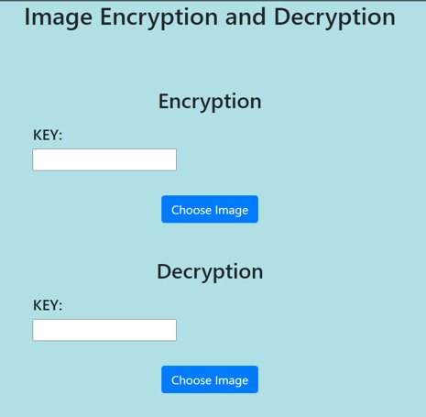
Result

Slide 7
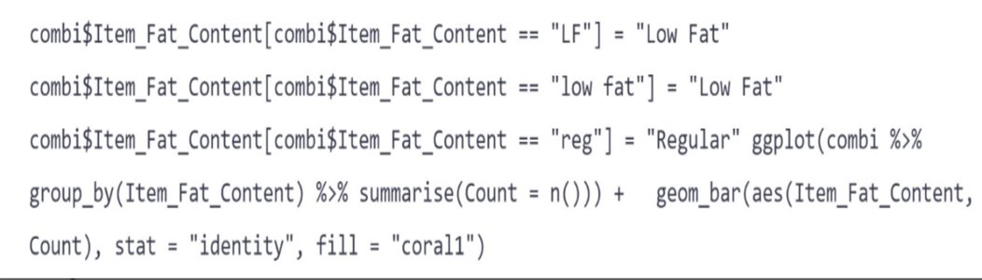
Original Image

Slide 8

Encrypted Image

Slide 9
Future Scope
We can increase the complexity of the mathematical operation that we are performing for the encryption purpose
We can add the feature in this application so that whole directory of images can be encrypted directly

